Slide 1
Steps for Uploading data in PACS

Slide 2
Dissolved phase Image Upload
The following slide will create DICOMS in python

Slide 3
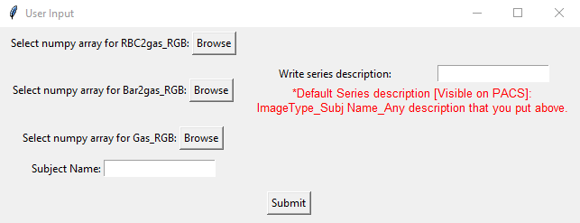
Steps
Clone the following Github link
https://github.com/Afia-59/Create_DICOM.git
Open this directory in a folder.
Run the code ‘Create_DICOM_from_Numpy.py
This code will read in .npy file for Gas_RGB, RBC2Gas_RGB and Mem2Gas_RGB. The DP reconstruction pipeline would spit out these files. For detail, go to https://github.com/Afia-59/Duke_DP_Recon_MyPC.git
4. A box would pop up. Fill out the following and hit ‘submit’.
5. The code will create 3 different folders containing the respective
Dicoms.

Slide 4
Tips during uploading at PACS system

Slide 5
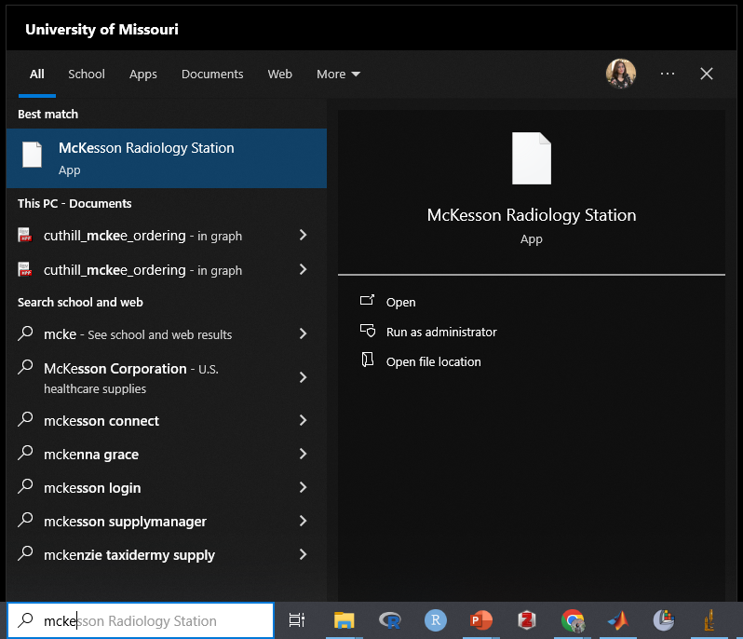

Slide 6
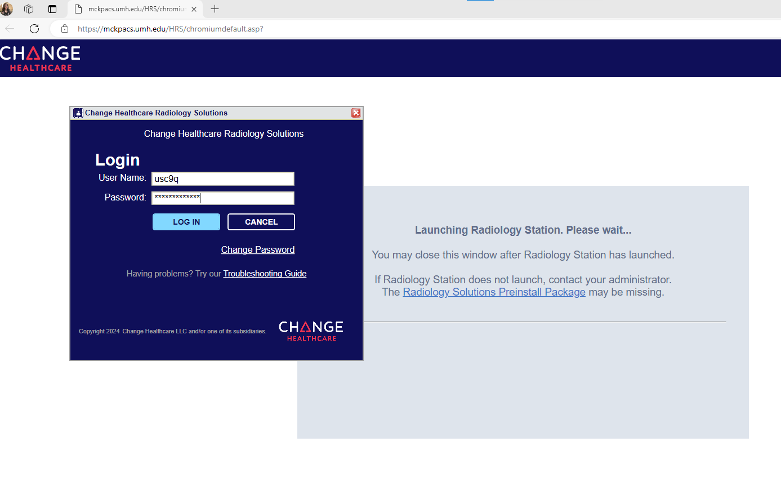

Slide 7
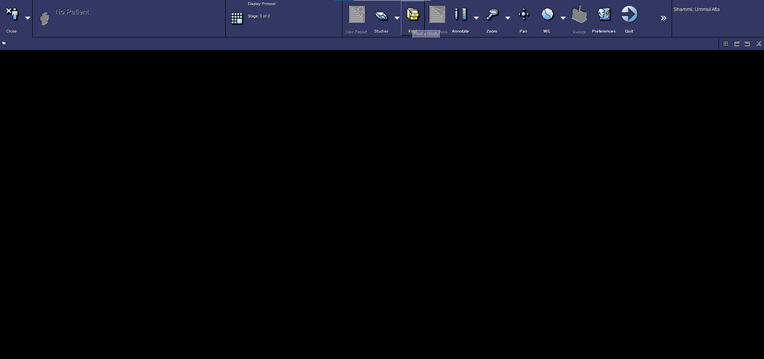

Slide 8
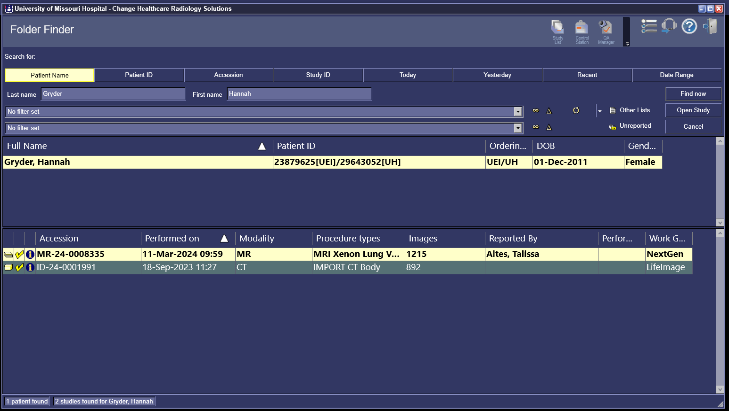

Slide 9
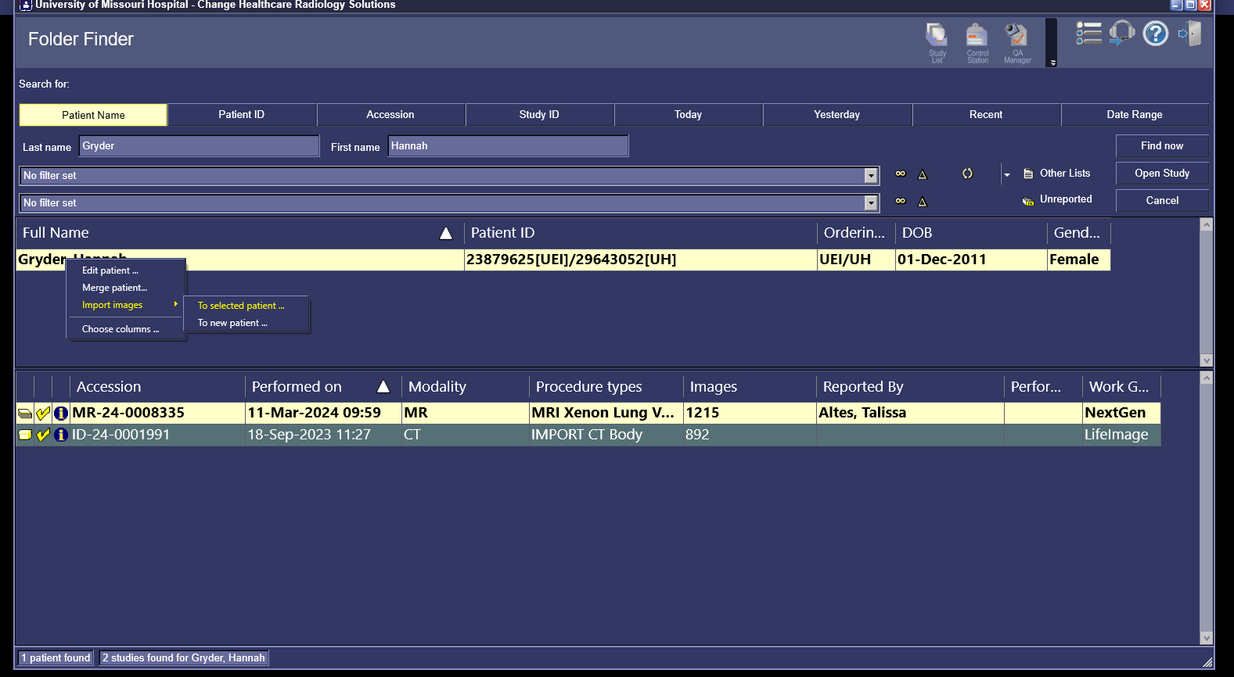

Slide 10
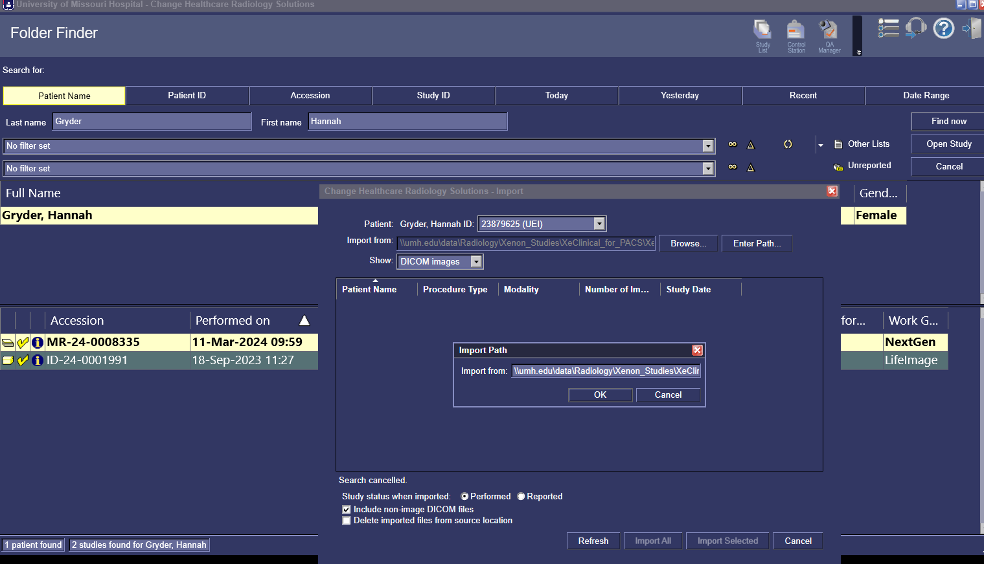

Slide 11
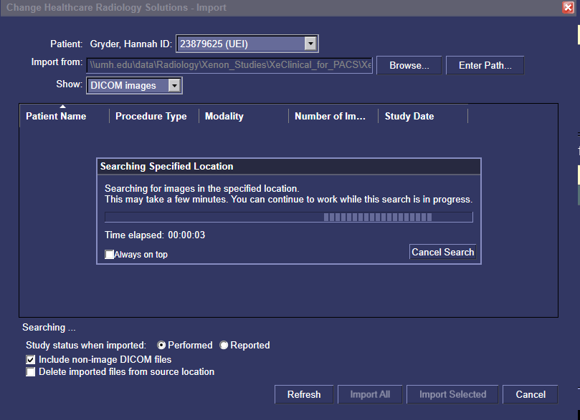
This can take few minutes

Slide 12
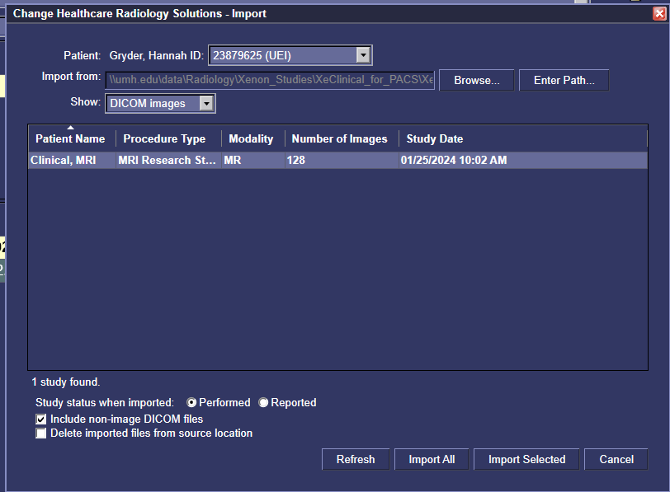

Slide 13
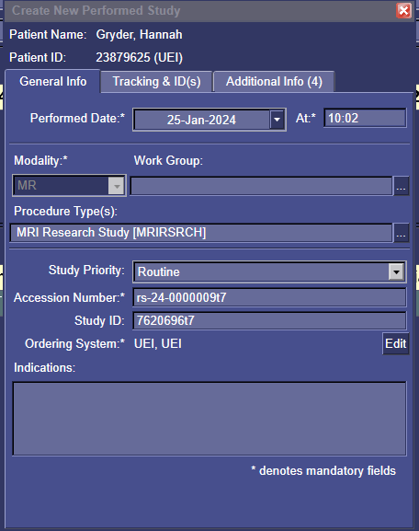
Change your accession number & Study ID & hit ok
A few minutes later, the files should be uploaded

Slide 14
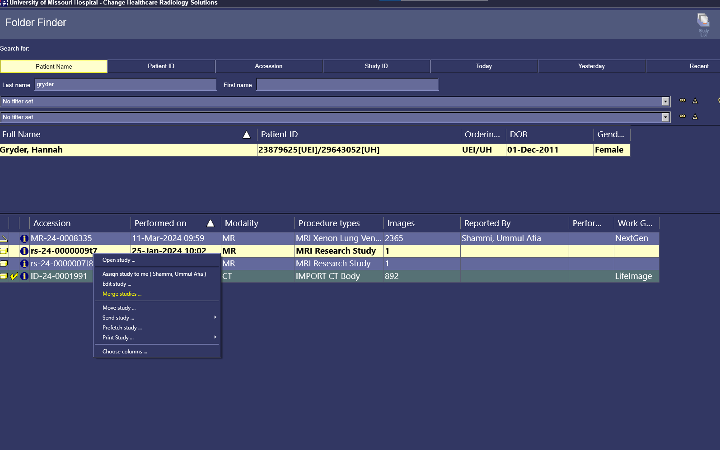
Now you need to merge it with the original case

Slide 15
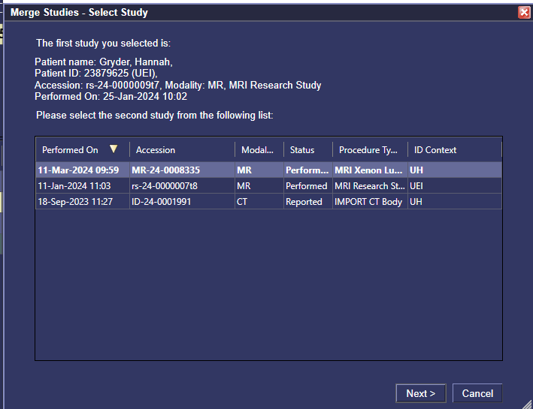
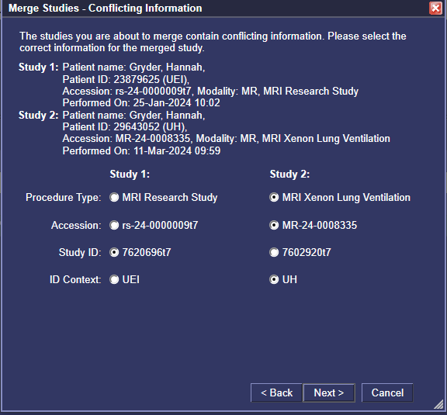
While merging, merge the accession numbers so that the new analysis is combined with the existing study.
But keep the study ID different from the existing study

Slide 16
Vent 2D Image Upload
Since I have most of my data saved as .R file, so my code reads in the R file first
The following slides creates DICOM in MATLAB

Slide 17
Step 1: R Analysis
Do your Vent DP analysis on R
Save the MR, Defect Array, VDP from your analysis
Load your saved R file
Then run the code below
Notes:
##Create a folder where you would save your .Tiff files
saved_path= '//umh.edu/data/Radiology/Xenon_Studies/Studies/XeClinical/ClinicalPatient3/Vent_defetcs_Tiff_ratioFixed/'
##Load your R file. My R file has the followings "defectArray" , "defectPercent", "HP" , "HPrfc", "id", "Mask" , "time"
MR=HP
VDP=round(defectPercent*100)
#defectSlide
colorList = c("#FFFF00" ,"#0000FF", "#FF0000", "#A800FF" ,"#FF9900", "#00E6B3" ,"#008CE6" ,"#00FF00", "#999999", "#00FFFF" ,"#FF80CF" ,"#FFFF00" ,"#0000FF", "#FF0000" ,"#A800FF" ,"#FF9900","#00FF00" ,"#8C6E00" ,"#999999" ,"#00FFFF" ,"#FF80CF")
s = seq(0,1,length=256)
colorRamp = c(colorList,rgb(s,s,s))
for(frame in 1:dim(MR)[3]){
A = (defectArray[,,frame]==0)*((MR[,,frame]*255/max(MR[,,frame]))+21)
B = (defectArray[,,frame])*2
C = A+B+0.00001
name=paste0(saved_path,sprintf("%004d",frame),'.tiff')
tiff(name,height = dim(MR)[1]*2,width = dim(MR)[2]*2)
par(mar=c(0,0,0,0))
image(t(C[dim(C)[1]:1,1:dim(C)[2]]),zlim=c(0,21+256),col=colorRamp,axes=FALSE)
text(0.2,0.9,paste0("VDP: ",VDP,"%"),col="red",cex=2)
dev.off()
}

Slide 18
Step 2: Convert .Tiff to dicom
Now you need to create dicoms which can be created in matlab
Run the following code
Notes:
%Code path: \\umh.edu\data\Radiology\Xenon_Studies\Studies\XeClinical\ClinicalPatient1\tiff2dcmforVentindvDCM.m
clc;clear all;close all;
fileList = dir([pwd '/*.tiff' ]);
%Here pwd is the path to my tiff file
saved_path=pwd;
% The dicom header should be similar to the acquired HPG MRI. Give location
% to your xenon MRI file
info = dicominfo('\\umh.edu\data\Radiology\Xenon_Studies\Studies\XeClinical\ClinicalPatient3\DICOM\HPImg\64397094_Xe');
for i=1:numel(fileList)
myfile=strcat(fileList(i).folder,'\',[fileList(i).name]);
myimg(:,:,:,i)= imread(myfile);
end
filename= strcat(saved_path,'\','Vent.dcm');
dicomwrite(myimg,filename,info,"CreateMode","Copy","MultiframeSingleFile",true);

Slide 19
Dissolved phase Image Upload
The following slides creates DICOM in MATLAB
We will upload the following,
Bar 2 Gas [binned]
RBC 2 Gas [binned]
Gas [binned]

Slide 20
In Ubuntu: Duke DP Reconstruction, Save analysis as nifty
In ImageJ: Convert those nifty into Tiffs
In MATLAB: save it as Tiffs again
In MATLAB: read in those tiffs and create customized dicoms
In MATLAB: read in the Tiffs and adds captions/ color bar on it
Here is how I am writing my Code
[Need to improve this pipeline]
In Ubuntu: Add DICOM Creation Section for Duke DP Reconstruction
Proposed pipeline

Slide 21
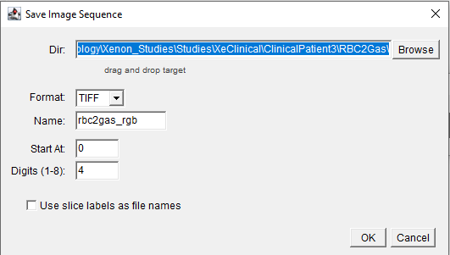
Step 1:
Usually, Duke DP reconstruction pipeline saves Bar 2 Gas [binned], RBC 2 Gas [binned] and Gas [binned] files as .nii. If the pipeline don’t save it as nifty, make sure, you are doing it.
Open each .nii file on imageJ and simply convert it into .tiff and save it.
on ImageJ, Go to File>Save as > Image Sequence: Select your directory, Format: TIFF

Slide 22
Step 2:
Run the following code on matlab. For some reason, the code doesn’t work if you run it all at once. Try to run it step by step.
Notes:
%%Code path: \\umh.edu\data\Radiology\Xenon_Studies\Studies\XeClinical\ClinicalPatient1\tiff2barAdd2indvDCM.m
%%Need to fix a bug in this code. For some reason, this code only works if
%%you run in step by step, not all at once. Run from Line 1-10 (make directory),Line 12-41 (read tifs), Line 4-68 (Create tif images with color scale)
%%Then Line 44-70 (Create tif w scale). Then run from Line 69-Rest (Create dicom from tif)
clc; clear all;
close all;
%% Create a directory
selpath = uigetdir(path);
mkdir AllDicoms
%% Read in Tifs
saved_path= strcat(selpath,'\','AllDicoms');
fileList = dir([selpath '/*.tif' ]);
selColormap = input('Bar2Gas= 1, RBC2Gas =2, Vent =3: ', 's');
selProtName = input('Enter Protocol Name ', 's');
numericValue = str2double(selColormap);
%% Barrier -Check if this color scale is accurate with your analysis
if (numericValue ==1)
myColormap(1,:) = [1, 0, 0] ;%lowest value,red
myColormap(2,:) = [1, 0.7143, 0] ; %# yellow 2
myColormap(3,:) = [0.4, 0.7, 0.4] ;%# yellow - GREEN 3
myColormap(4,:) = [0, 1, 0] ;%# GREEN 4
myColormap(5,:) = [184.0/255.0, 226.0/255.0, 145.0/255.0];
myColormap(6,:) = [243.0/255.0, 205.0/255.0, 213.0/255.0];
myColormap(7,:) = [225.0/255.0, 129.0/255.0, 162.0/255.0];
myColormap(8,:) = [197.0/255.0, 27.0/255.0, 125.0/255.0]; %# highest value
end
%% Ventilation & RBC: Check if this color scale is accurate with your analysis
if (numericValue==2 || numericValue ==3)
myColormap(1,:) = [1, 0, 0] ;%# defect 1
myColormap(2,:) = [1, 0.7143, 0]; %# yellow 2
myColormap(3,:) = [0.4, 0.7, 0.4]; %# yellow - GREEN 3
myColormap(4,:) = [0, 1, 0]; %# GREEN 4
myColormap(5,:) = [0, 0.57, 0.71]; %# green 5
myColormap(6,:) = [0, 0, 1]; %# high-intense 6
end
%% Reading tiffs and adding color bar and sequence names
figure;
for k = 1:size(fileList,1)
myimg= imread([fileList(k).name]);
myimg= insertText(myimg,[15 15],selProtName,FontSize=10,BoxColor="black",TextColor="white", BoxOpacity=1,AnchorPoint="LeftBottom");
imshow(myimg,'DisplayRange',[]);
set(gcf,'Color','none');
colormap(myColormap);
c = colorbar;
c.AxisLocation='in';
c.Location='eastoutside';
caxis([0 25.0]);
c.Ticks = [];
name=strcat(saved_path,'\img',num2str(sprintf('%04d',k)),'.tif');
exportgraphics(gcf,name,...
'BackgroundColor','k')
end
%% Saving each tiff as individual dicoms
fileList = dir([saved_path '/*.tif' ]);
loc=-64;
info = dicominfo('\\umh.edu\data\Radiology\Xenon_Studies\Studies\XeClinical\ClinicalPatient2\SingleSession\DICOM\77835004Xe');
for i=1:numel(fileList)
myfile=strcat(fileList(i).folder,'\',[fileList(i).name]);
myimg= imread(myfile);
info.InstanceNumber=i;
info.SliceLocation=loc;
info.SeriesDescription=selProtName;
info.ProtocolName='DP';
info.SequenceName='DP';
info.PatientName.FamilyName='Clinical';
info.PatientName.GivenName='MRI';
info.NumberOfFrames=1;
info.PerFrameFunctionalGroupsSequence=[];
filename= strcat(saved_path,'\',fileList(i).name,'.dcm');
dicomwrite(myimg,filename,info,"CreateMode","Copy","MultiframeSingleFile",true);
loc=loc+1;
end

Slide 23
Other software
For editing DICOM

Slide 24
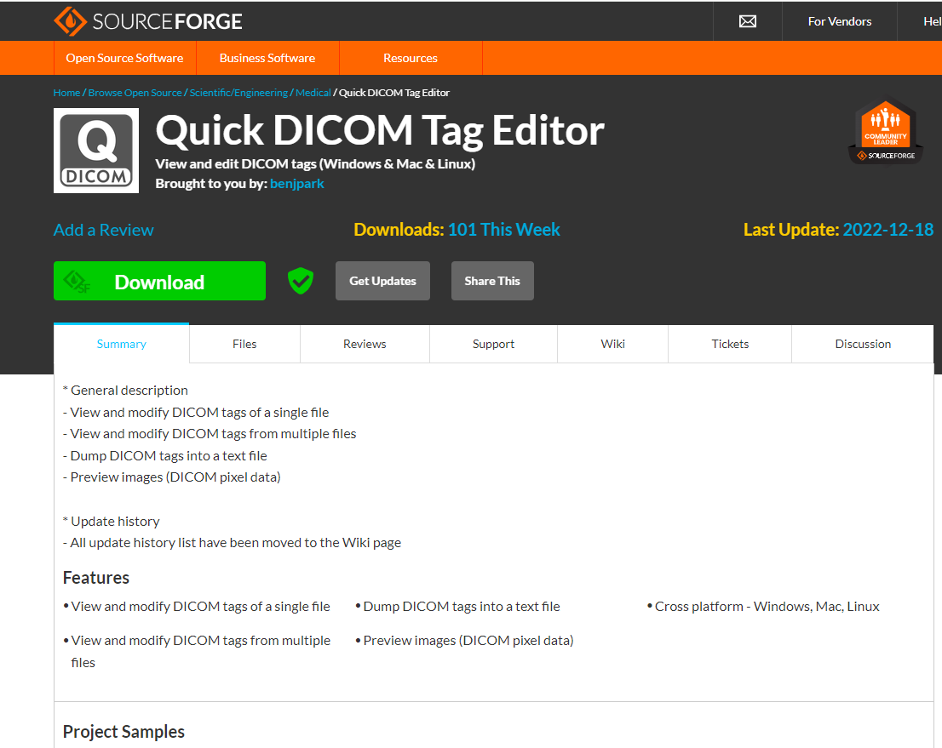
Download quick dicom edit
Notes:
https://sourceforge.net/projects/dicomeditorbybenp/files/latest/download

Slide 25
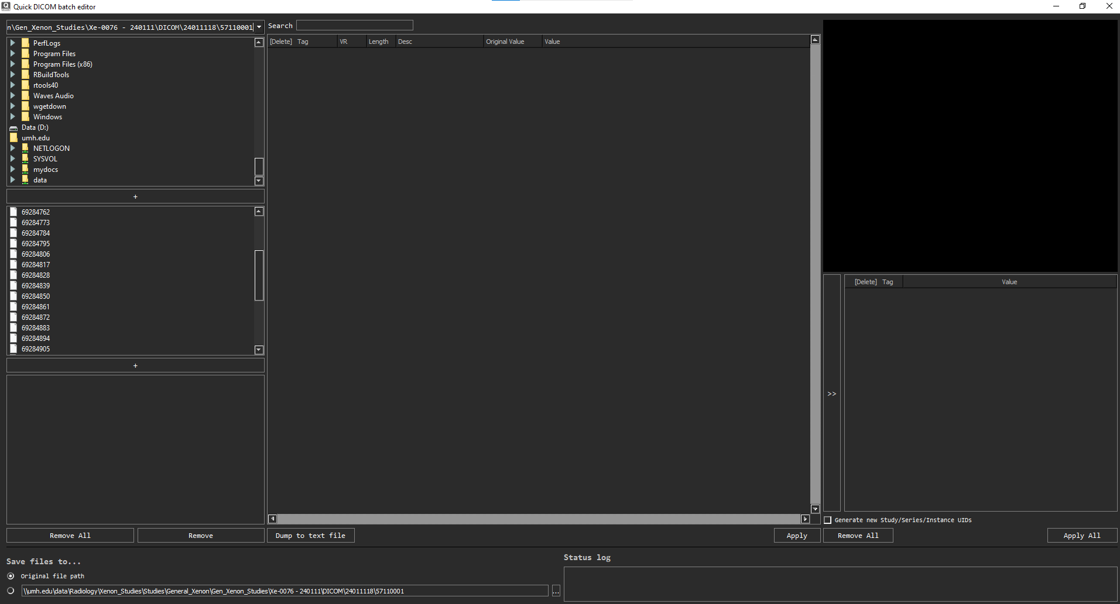

Slide 26
